Slide 1

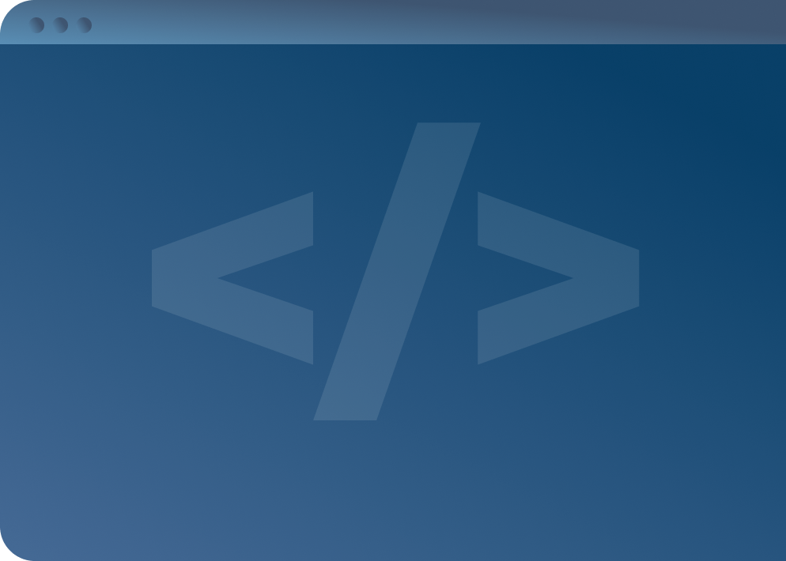

SOFTWARE DEVELOPMENT PROFESSIONAL PROGRAM
Client-Server Architecture

Slide 2





Client-Server Architecture
Learning Objectives
Describe the differences between a client and a server.
Diagram the request-response cycle.
Identify the different parts of a URL.

Slide 3


Client-Server Architecture
The Internet
The internet we use daily is heavily based on the client-server model. It facilitates the interaction between clients and servers.
Cookie the Pom

Slide 4


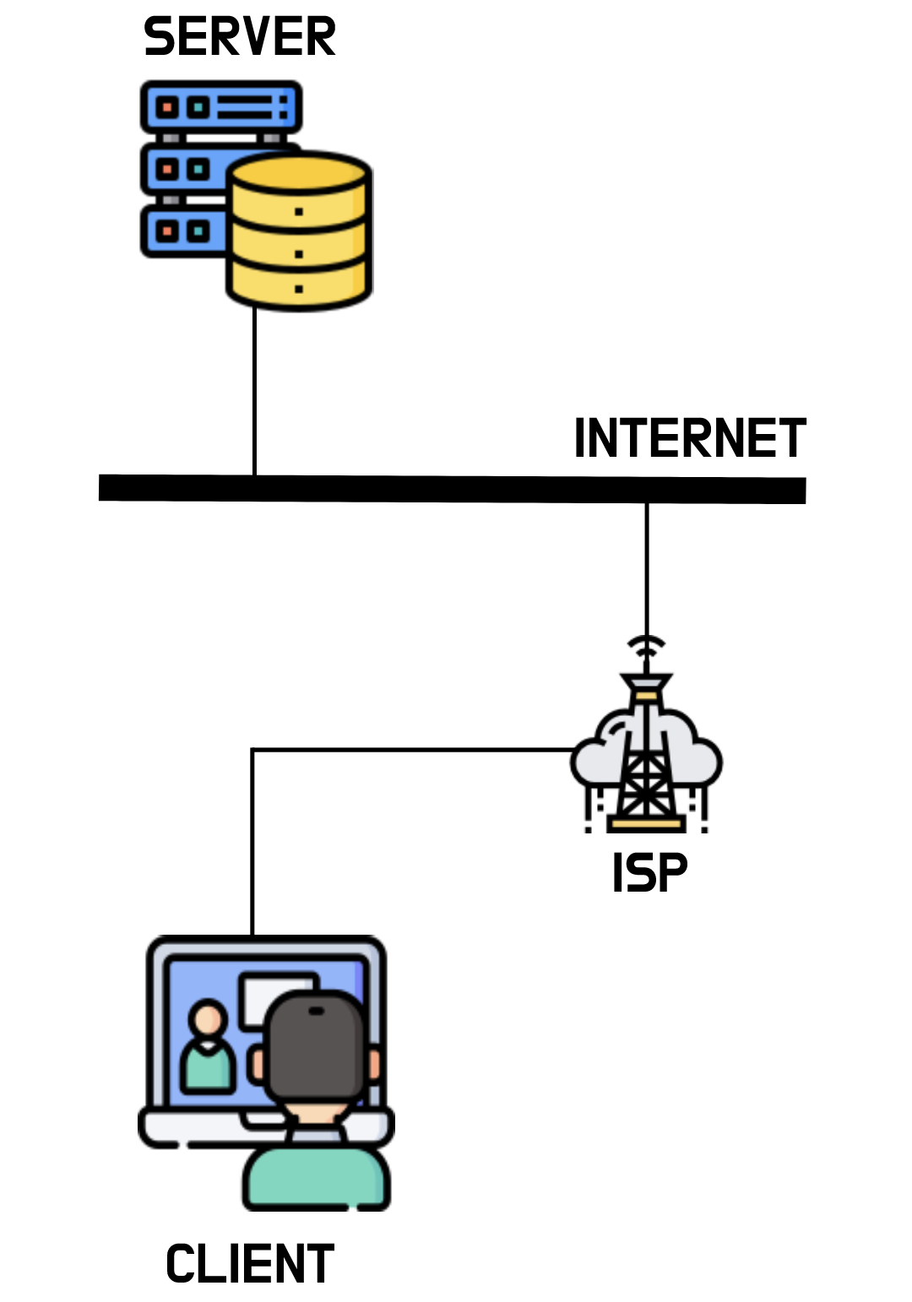
Client-Server Architecture
Clients vs. Servers
Server
Client
A special computer that is always on and directly connected to the internet
Provides some sort of functionality or data to clients
Computers we use to interact with the internet indirectly through an internet service provider (ISP)
Notes:
See question #1 in the lesson companion.

Slide 5
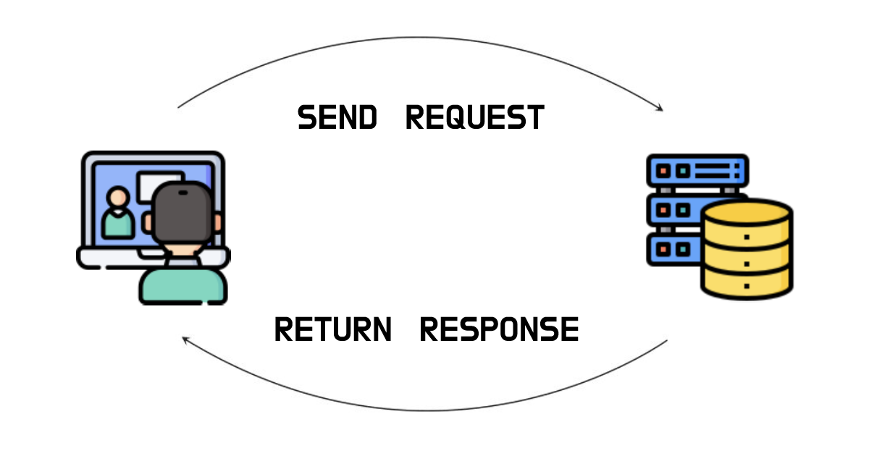
Client-Server Architecture
Request-Response Cycle
Clients send a request to the server.
Servers return a response to the client.
These requests and responses are sent through the internet.
Notes:
An analogy is sending snail mail. We (the client) send a letter (request) to another person (the server), and they send
back a response. For the letters to reach their destinations, the post office (the internet) must facilitate the exchange.
See question #2 in the lesson companion.

Slide 6

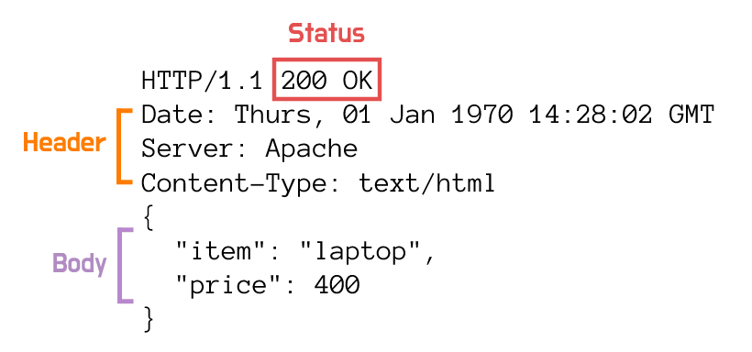
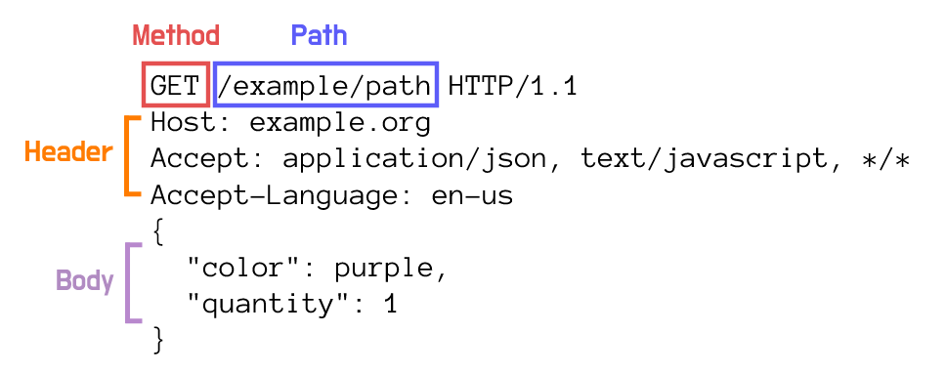
Client-Server Architecture
Building Blocks of Requests & Responses
Responses
Requests
Notes:
Acknowledge this may be confusing to learners. The following slide will present an analogy to further contextualize the
parts and their functions. See question #3 in the lesson companion.

Slide 7

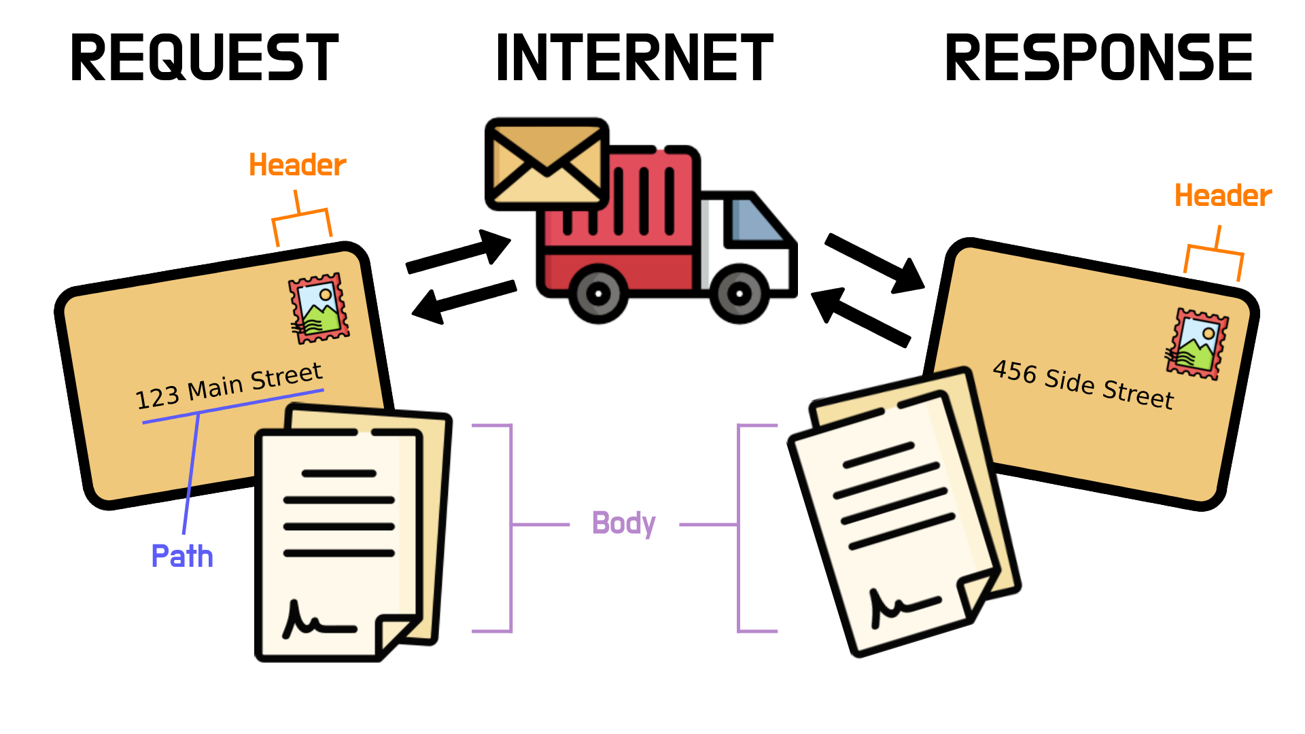
Client-Server Architecture
Request-Response Analogy: Snail Mail
Notes:
To send our letter (request), we must include an address (path) to where we want it to go. We must also include a stamp
(header) on the envelope for the post office to send it. The content of our letter (body) includes everything we want the
recipient to know. The delivery truck acts as a middleman, taking our letter and sending it to the receiver and vice versa,
just like the internet facilitates the exchange of data between a client and a server. To send back a reply (response),
our penpal must also include a stamp (header) and have a letter (body) responding to whatever we asked for. Receiving a
response would be like a 200 status, while receiving our letter back with a "return to sender" stamp would be like a 400
error status.

Slide 8

Client-Server Architecture
C.R.U.D
A client may request four main actions:
Post (Create data)
Get (Read data)
Put/Patch (Update data)
Delete (Delete data)
Notes:
If learners ask about other available methods, send them the MDN link for HTTP methods:
https://developer.mozilla.org/en-US/docs/Web/HTTP/Methods

Slide 9


Client-Server Architecture
Hypertext Transfer Protocol
HTTP
A client-server protocol that allows HTML documents to be requested and displayed
Allows the web to be interactive
The basis for how data is exchanged over the web
Notes:
Before discussing HTTP, explain that a protocol for the web describes how data is exchanged between computers.
If learners ask, define hypertext: text displayed on computers that contains links to other texts, allowing users
easy access from one text (document/page) to another.

Slide 10

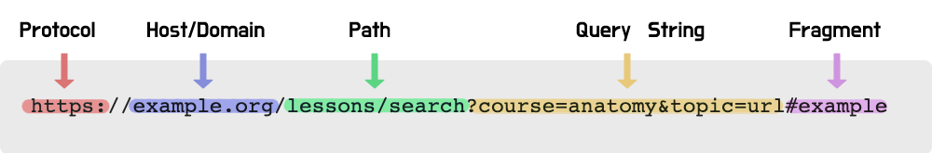
Client-Server Architecture
Anatomy of a URL
Protocol: Determines which protocol to use
Host/Domain: The address of the server providing resources
Path: The path to the exact resource of the server you want to access
Fragment: Identifies a specific section of the response
Notes:
GitHub markdowns are examples of fragments. Consider demonstrating how they work. You can use the React GitHub README
(https://github.com/facebook/react/blob/master/README.md#contributing) or one of your own. See question #4 in the lesson
companion.

Slide 11

Client-Server Architecture
Front End vs. Back End
Front End
Back End
What users see and interact with on the browser
Graphical user interfaces with HTML, CSS, or JavaScript
What we have built so far
The parts of the web we do not see directly
What crunches/holds data and runs logic
Notes:
The front end and back end interact using a request-response cycle. The front end requests data from the back end, and the
back end responds with data for the front end to display.

Slide 12
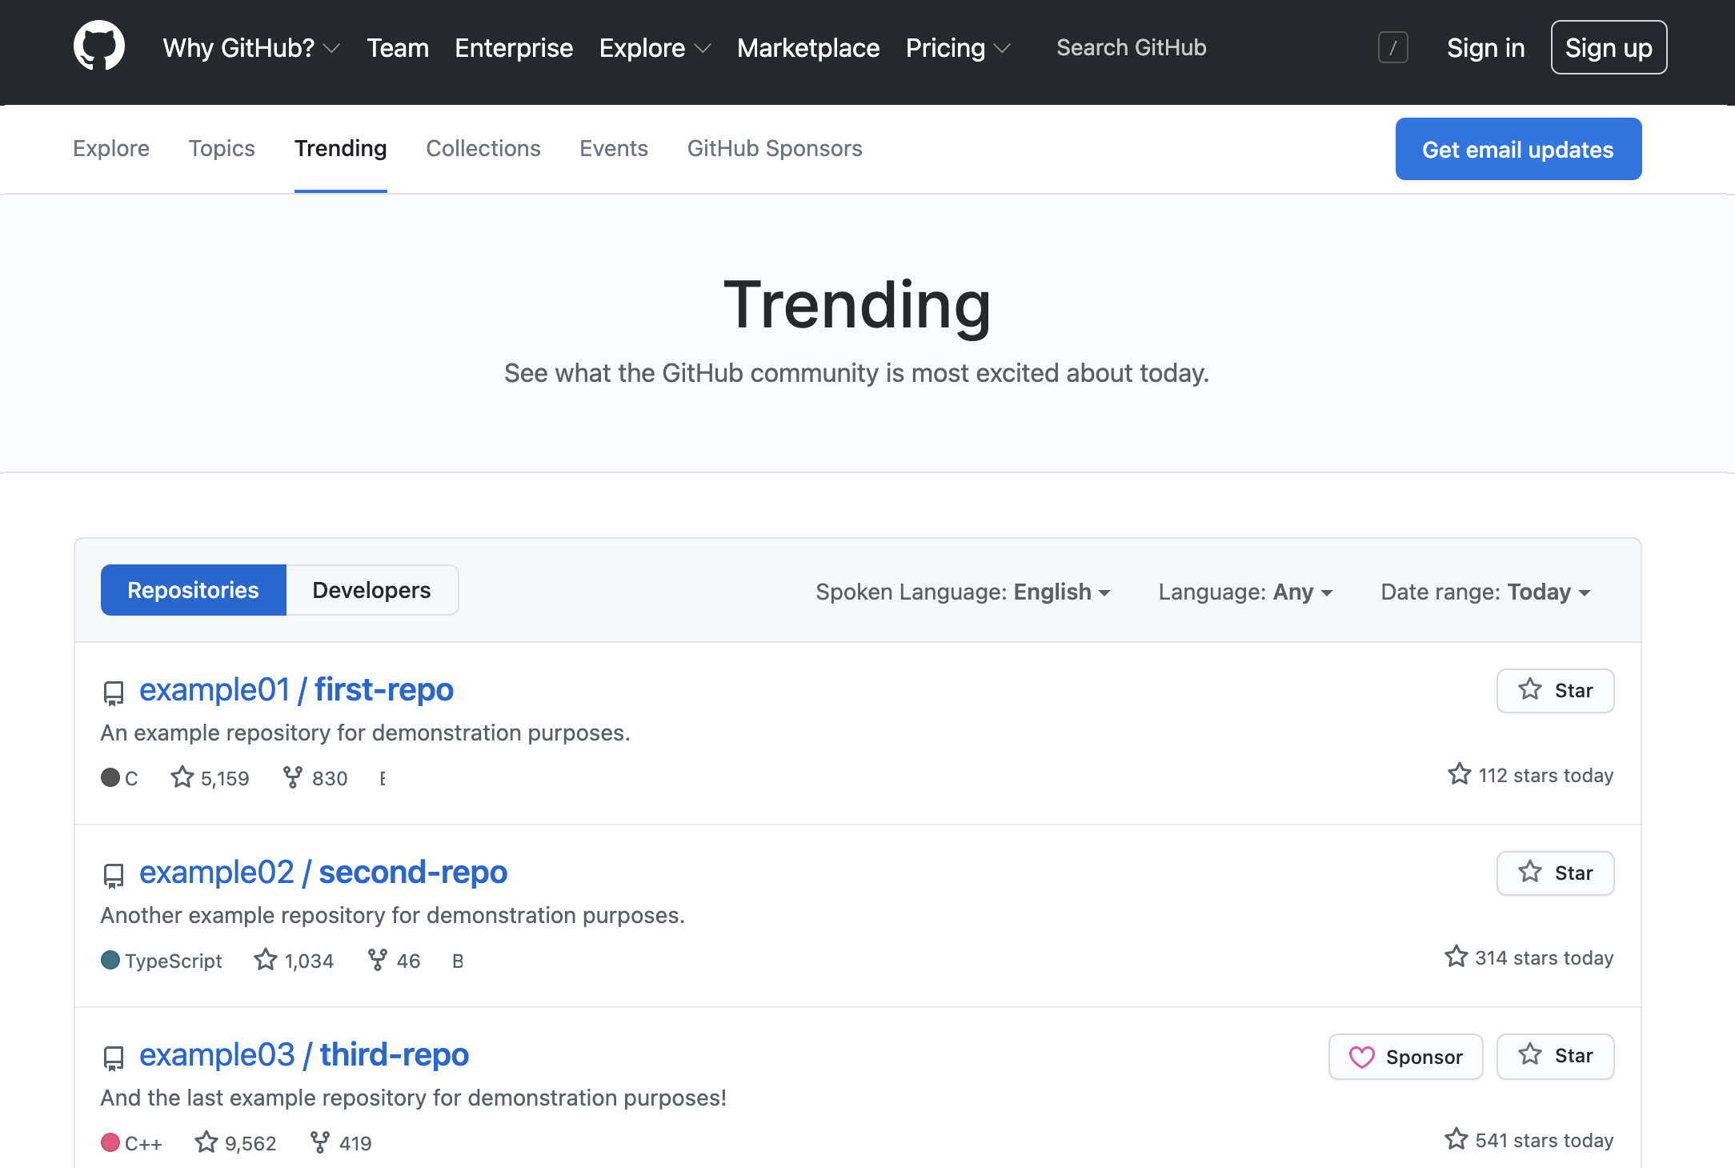
Client-Server Architecture
Example: GitHub
GitHub has thousands of users and repositories with their own webpages.
How do you think each page is created for users to see?
Notes:
Explain that GitHub doesn't have a sleepless team of developers hand-writing every page as it is uploaded. Instead, the
pages are built dynamically using an HTML template that relies on data to fill in the blanks. This requires a server and
a database. In other words, GitHub is made up of a front end that displays data fetched from the back end, which is stored
in its database.

Slide 13

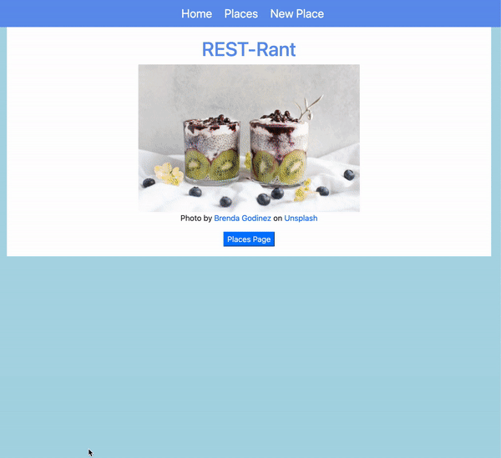
Client-Server Architecture
The Big Picture
Notes:
By the end of the sixth course, learners will be able to build their own web application made up of a front end and back
end. Use this time to give them a big-picture overview of what they will learn throughout this course (MongoDB as their
database, Express/Node as their back end, JSX as their front end, etc.).

